Slide 1

Social Network Analysis of Zhihu
Group 9
Gu Zhijing, 1155073548
Huang Xianghai, 1155055168
Lyu Zishen, 1155071037
Zhao Che, 1155066626

Slide 2
Overview
Motivation
Obtain Data
Basic Statistics
Graph Analysis
Summary

Slide 3
Motivation
Zhihu (www.zhihu.com) is the biggest Chinese knowledge ask-answer web site in China (example in English world: Quora). It has more than 17 million registered users (over 10 million among them are monthly active) by March 2015
We wonder in such a platform, what kind of form of social network may existsa, and we want to know whether the knowledge areas (topics) have any contact with the interpersonal relationships (which is a special issue of Zhihu compared to social websites like Twitter or Facebook).

Slide 4
Obtain Data
Features We Care About
- User can have many followees and follower - directed relationships;
- Question (asked by users) can have several topics wiki-tagged;
- User can have only one answer in one question;
- Answer can get agree and thanks from other people;
Database Design
User (user_url, user_id, answer_num, followee_num, follower_num, agree_num,
thanks_num, layer)
Question (question_id, topic) UserQuestion (user_url, question_id)
Following (user_url, followee_url) UserTopic (user_url, topic)
Notes:
- User
- user_url
- user_id
- answer_num
- followee_num
- follower_num
- agree_num
- thanks_num
- is_crawled
- layer
- Question
- question_id
- topic
- Following
- user_url
- followee_url
- UserQuestion
- user_url
- question_id
- UserTopic
- user_url
- topic

Slide 5
Obtain Data
Crawler
- Implemented in Python, based on an open source package called “zhihu-python”;
- Apply multiprocessing to crawl data on a single machine due to resource limitation;
- Automated crawling, with automatic error handling;
- Data crawled are stored in csv files in the first place, and are transferred to Sqlite
database afterwards for later processing;

Slide 6
Obtain Data
Crawling Strategy
- For one individual user: crawl porfolio information, followers and followees, question_ids
of questions he or she has answered;
- Crawl two followee layers from a pre-defined seed user (zhao-che);
- Handle one list of distinct user_url to avoid the subtree replication of the same user
(e.g. A->B, C->B);
- Crawl the topics of the questions based on the question_ids we have got.
Depth First v.s. Width First
- DF can crawl all the users in the whole website but time is not allowed;
- WF is more flexible when we only want to crawl several layers from the seed, without
any lost.

Slide 7
Obtain Data
Summary of obtained data
SQLite .db file: 688MB
User: 26K, Following: 4.6M, Question: 2.2M, UserQuestion: 1.7M
UserTopic: 5.4M (Joined by UserQuestion and Question)

Slide 8
Basic Statistics
User’s followee, follower, answer, agree, thanks
Follower: mean 3620.0, median 112.0, standard deviation 22978.5 305(zhao-che)
Followee: mean 176.3, median 67.0, standard deviation 565.9 149(zhao-che)
Answer: mean 68.9, median 17.0, standard deviation 225.9 120(zhao-che)
Agree: mean 3858.4, median 96.0, standard deviation 21951.4 828(zhao-che)
Thanks: mean: 865.3, median 28.0, standard deviation 4627.6 290(zhao-che)

Slide 9
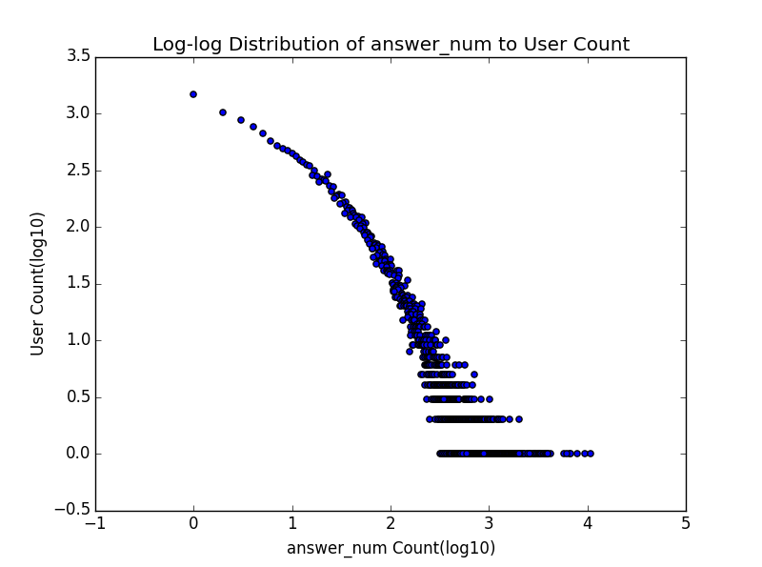
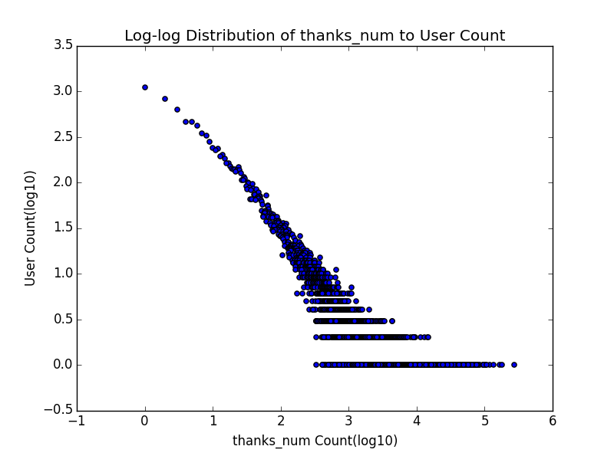
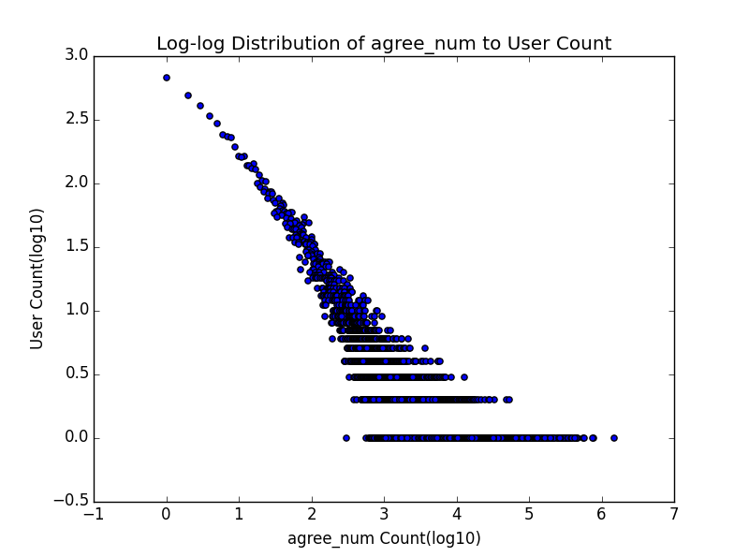
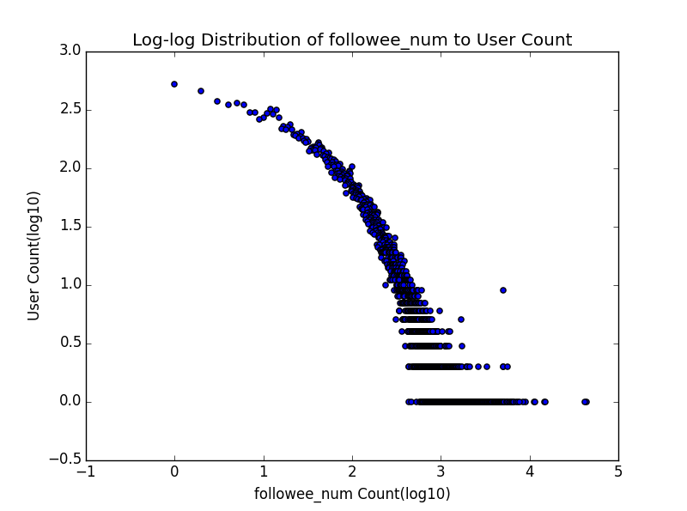
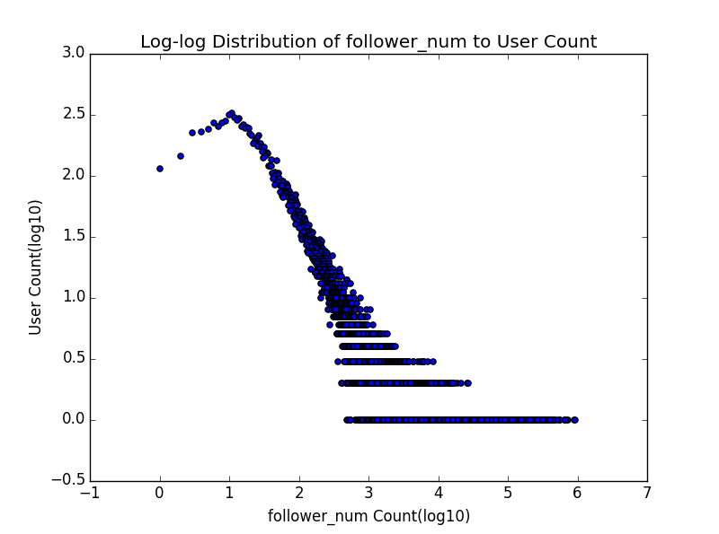
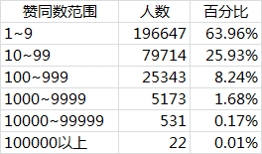
Basic Statistics
Log-log Distribution
Followee: Out Degree
Follower: In Degree
Answer, Agree, Thanks
We can see significant power
law in all five features of users.
Similar Statistics: http://zhuanlan.zhihu.com/sulian/19781120 3.5M Users

Slide 10
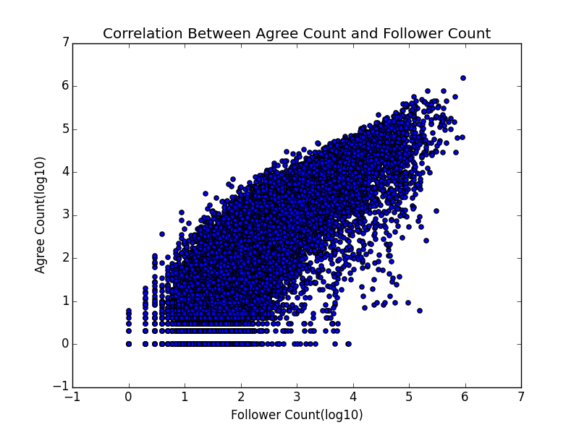
Basic Statistics
Correlation between Agree and Follower

Slide 11
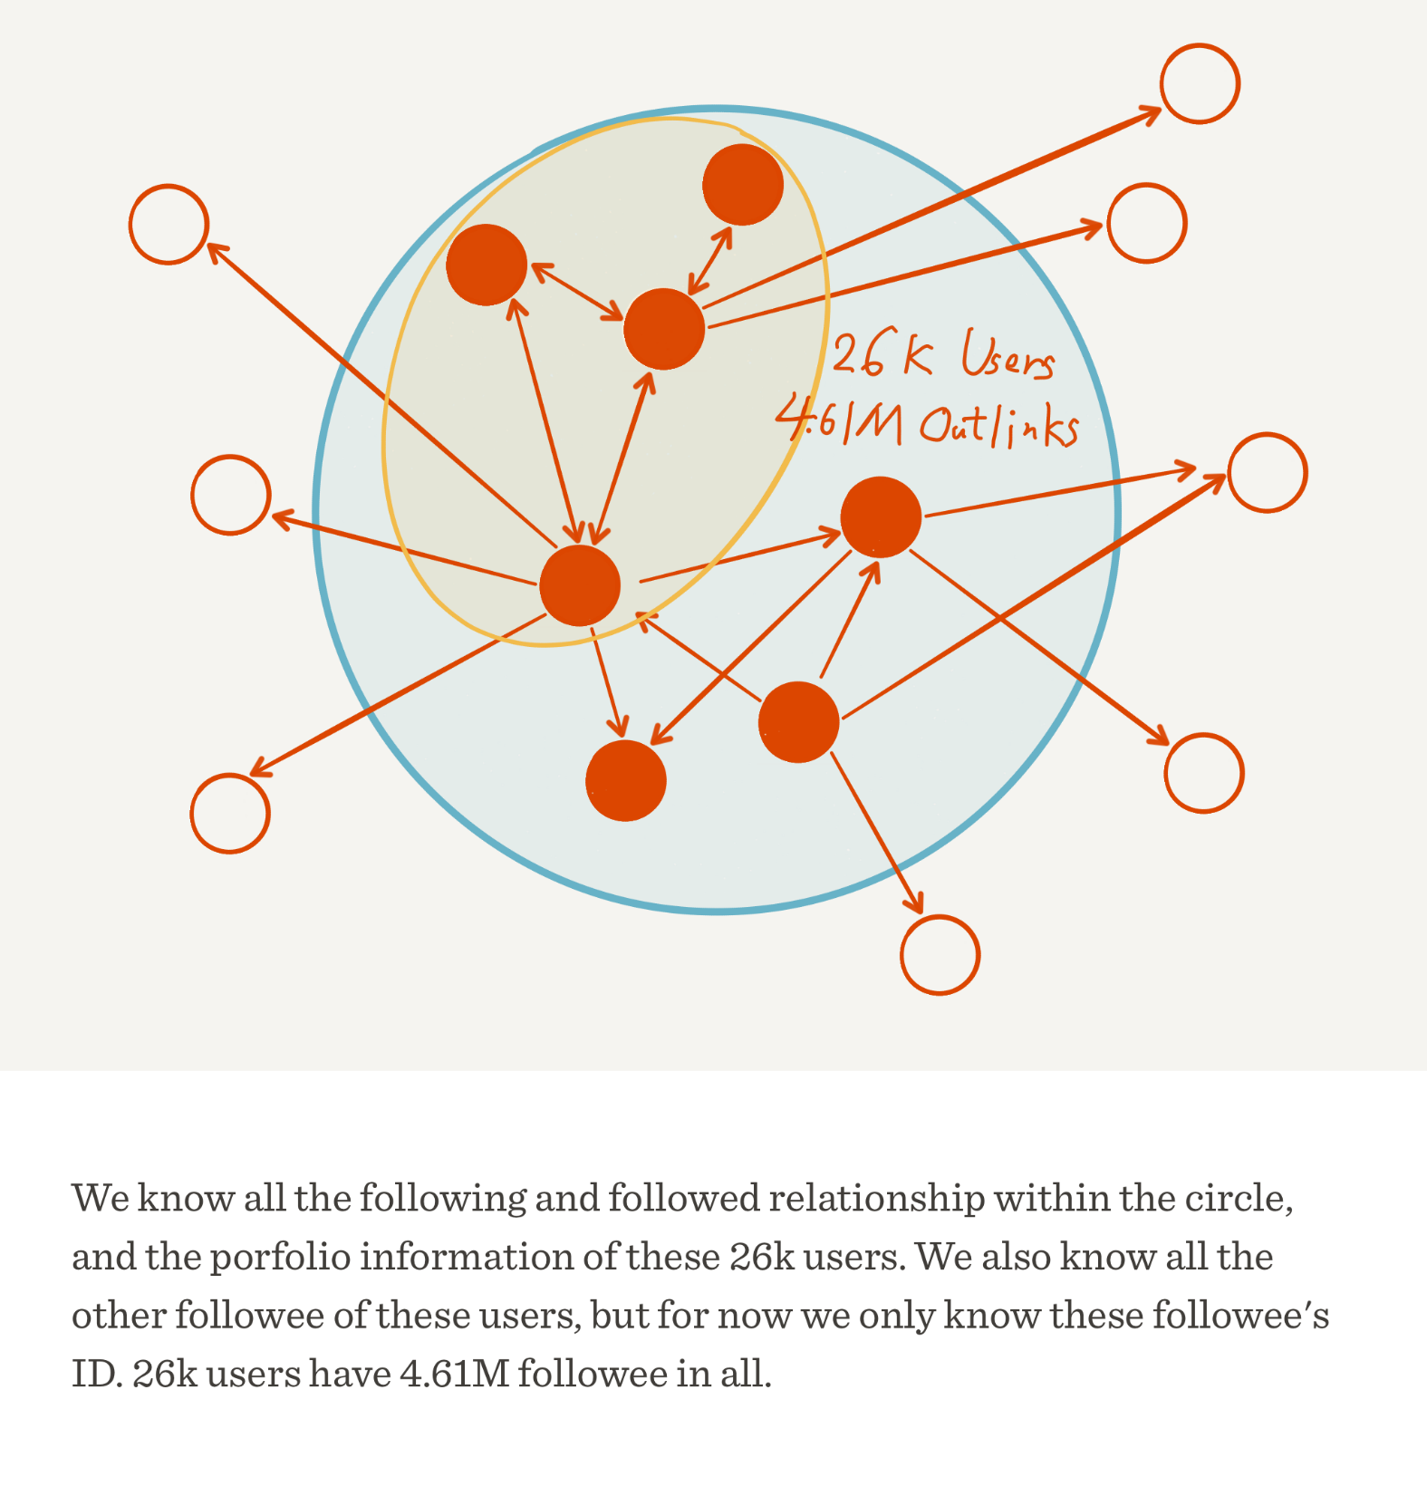
Graph Analysis
Following Graph Overview
Pick User Set
- We should define a user set to
analyse;
- We should avoid using outlinks
to users outside the user set.
SQL to handle:
select user_url, followee_url from
Following where followee_url in
(select user_url from User
where agree_num > 50000) and
user_url in (select user_url from User
where agree_num > 50000)

Slide 12
Graph Analysis(agree>10k)
Graph
Diameter, Radius: Graph not connected, infinite path length
Average Shortest Path Length: (Underestimate in networkx’s DiGraph [(1,2),(2,4),(3,4)],
0.42)
Density: 0.064

Slide 13
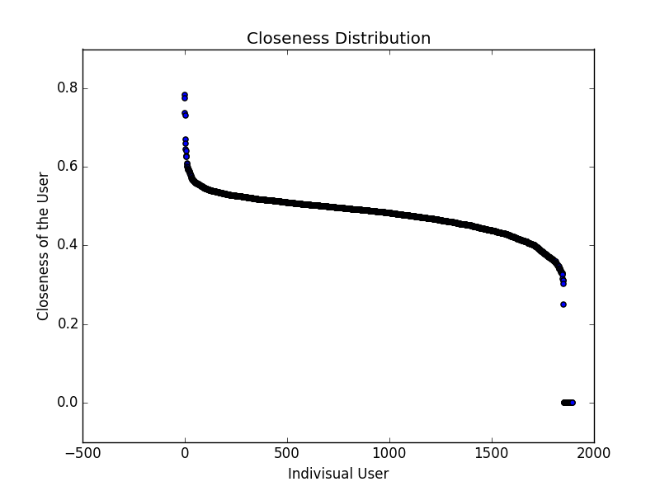
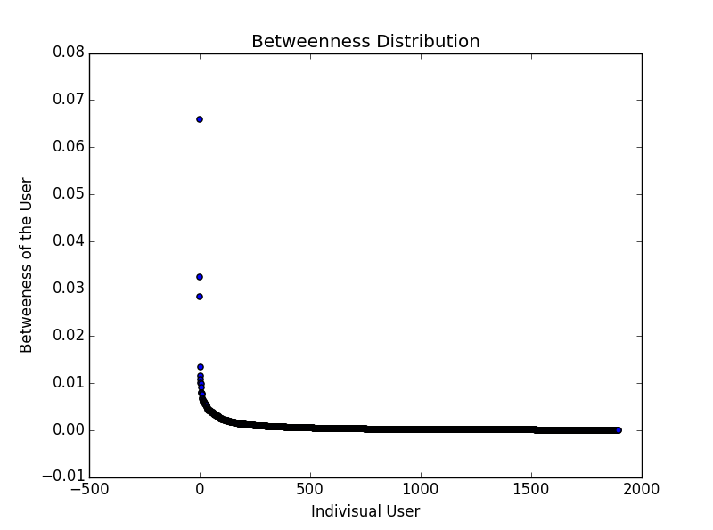
Graph Analysis(agree>10k)
Nodes
Betweeness: really low for every point, you don’t have to use a particular path.
Closeness: nodes are mostly equally important.

Slide 14
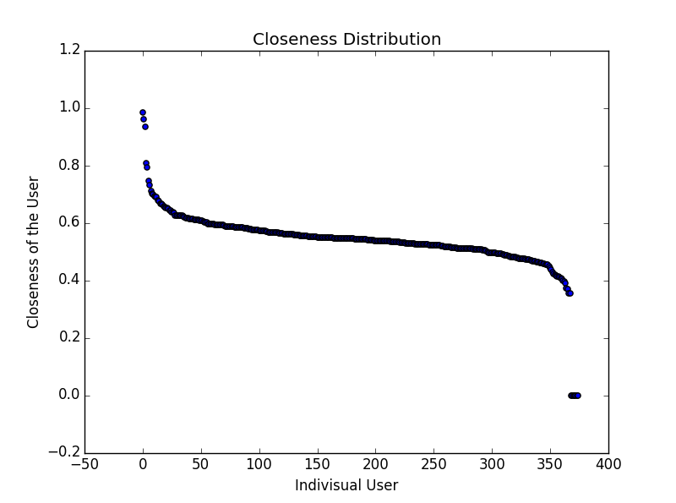
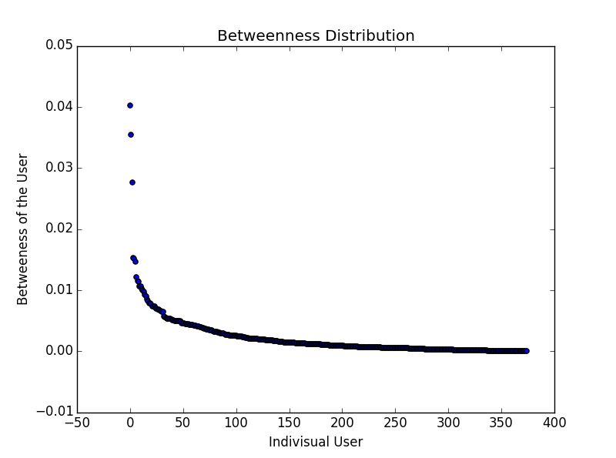
Graph Analysis(agree>50k)
Graph Density: 0.195(much larger than 0.064 in [agree>10k])
Nodes Centrality: similar with the [agree>10k]

Slide 15
Graph Analysis(agree>10k)
PageRank and HITS
PageRank top 3: jixin 0.0074, ma-bo-yong 0.0056, zhang-jia-wei 0.0055
Hub top 3: zhounuo 0.0034, Namoamitabhaya 0.0034, jun-mo-52 0.0034
Auth top 3: zhang-jia-wei 0.0034, liangbianyao 0.0034, gejinyuban 0.0032
These link analysis scores can also be used to rank topics (yet to be tried due to time
limit).
Notes:
pagerank top 100:
jixin 0.00736154141444
ma-bo-yong 0.00560076297825
zhang-jia-wei 0.00550553477041
gejinyuban 0.00509815838432
zhouyuan 0.00502536098254
raymond-wang 0.0049436297646
imike 0.00470534674512
liangbianyao 0.0044898091248
yolfilm 0.00438074532469
amuro1230 0.00411341044214
cai-tong 0.00408522324041
commando 0.00388067740733
fu-er 0.00375795748993
zhang-xiao-bei 0.00368473139513
zhu-xuan-86 0.00361963498991
xiepanda 0.00359374863181
nordenbox 0.00357331948562
magie 0.0035061809321
magasa 0.00347462930557
talich 0.00340541502424
Tian-Hao- 0.00335215709172
chenqin 0.00330580008172
lawrencelry 0.00329359207676
keso 0.00323661070011
xiaodaoren 0.00321440822062
wangnuonuo 0.00316563471091
kaifulee 0.00311427077926
wangxiaofeng 0.00310321795708
chibaole 0.00306540886097
aton 0.00304029368837
zhou-xiao-nong 0.00301645788717
fenng 0.00295839758417
su-fei-17 0.0028402514463
dong-ji-zai-hang-zhou 0.00279157612441
leng-zhe 0.00275698029638
dongdongqiang 0.0026839752022
lisongwei 0.00268314292358
bo-cai-28-7 0.00265256949015
miaomiaomiao 0.0025826877238
zombie 0.00256745689315
daguo 0.00255613050842
fei-niao-bing-he 0.00255550998547
cogito 0.00254631654427
tian-ji-shun 0.002509541071
cici 0.00247594407474
BlackCloak 0.00247324393931
cheng-yi-nan 0.00245636053642
Metaphox 0.00237760297006
DrHow 0.00237517128444
lianghuan 0.00234839862377
amonjok 0.00234750658604
chenbailing 0.00233996536562
gracelu 0.00230136329415
jing-lei 0.00230122412215
feifeimao 0.00229606238402
ccat 0.00229103133884
gu-che-dan 0.00227709910078
e-mo-de-nai-ba 0.00224224130973
matt-hartzell 0.00222257230416
shenbin 0.00221589526052
jilingbhl 0.00219119230263
jiaoshoutv 0.00217304845954
lianghai 0.00217140535832
chenghan 0.00216522109388
han-qing 0.00215962267406
hecaitou 0.00214624670063
ji-xuan-yi-9 0.00214585163429
excited-vczh 0.00211988444855
kaiserwang730 0.00211709839974
yandeng 0.00202552023236
imajin 0.00200947888581
linan 0.00200937544109
WxzxzW 0.0019982054122
an-jia-men-yuan 0.00198646974727
ma-qian-zu 0.00197736872355
ChenZhangyu 0.00197186214001
meng-de-er 0.00197083539113
guanyadi 0.00196901675307
cao-zheng 0.00194870898777
rosecrimson 0.00191374619116
huazong 0.00191374465692
haoqishiyanshi 0.00189840230449
yixiao-feng-yun-guo 0.00188342138021
mali 0.00187110846409
huma 0.00186711889011
zhang-jing-88-76 0.00186543747956
zhang-zhihao 0.00186462638092
benjamin 0.00185950043128
rio 0.00185136754677
ayat 0.00184929371814
billhan 0.00184286768243
lydia-62 0.00184045119365
rouni 0.00180301952824
zhangleo 0.00179197308264
ourdearamy 0.00175408571005
s0s0 0.00175161600701
Hemerocallis-Yu 0.00174604153394
yinshoufu 0.00174440845013
patrickluo 0.00172016673883
Mumagag 0.00170837118915
hub top 100:
zhounuo 0.00343969539768
Namoamitabhaya 0.00338392598422
jun-mo-52 0.00335828857008
qisini 0.00325085195986
wang-wang-wang-08-18 0.00289599389199
iaisin 0.00277358771947
yueyihe 0.00268622773776
edison-chen-8612 0.00258692962384
dong-jia-bin 0.0024967611873
li-xin-79-4-57 0.00241116921636
xiao-tao-qi-84 0.00238857377317
miaomiaomiao 0.00230616467841
jixin 0.00230293086118
phos 0.00227305340287
wang-sign 0.00225029431928
fuwocheng 0.00222426479365
lydia-62 0.00210412169166
meng-jue-99 0.00207669504391
hou-ye-60 0.00206490682686
mount_cristo 0.00205420041813
renfish 0.00202434704422
chenran 0.00200639847807
rz3000 0.002002672618
evafavor 0.00200057256251
ji-le-18 0.00196889207543
ywzgb 0.00196331364699
shen-ya-nan-44 0.00195958445326
tian-yu-bai 0.00194658692985
lie-feng-2 0.00194192171791
frank-17 0.00191245919524
li-ao-wen 0.00191201992509
nano.wang 0.00190944917844
liangbianyao 0.00183248664023
david.dai 0.00182970518024
song-wen-deng 0.00182633371925
zhao-___-si 0.00181423424596
mmyww 0.00180331491318
yin-ru-si 0.001779616441
yu-san-geng 0.00177656781182
teenieweenie-46 0.00177107095988
dizhe 0.00176445839043
tong-chen-13 0.00175981693183
liu-ting-ting-64 0.00172686553323
eternityi 0.00172124380947
chenkunting 0.00171271948993
NicolasYu 0.00171196346359
mo-wei-zhi-57 0.00169474743148
yskin 0.00168864488275
hao-lan-guo-53 0.00168841896593
jiang-nian-15 0.00167981071499
403Forbidden 0.00166886089239
sheng-tan-jin 0.00166139035626
xiezuoyou 0.0016532805205
wang-xiao-pi-18 0.00164449361476
ashej 0.00163886286716
hao-ao-fu 0.00163848647275
niu-yue-lao-li-xiao-chang 0.00163524397418
jiaji-deng 0.00163392762257
leocc 0.00162128910022
an-ji-14-73 0.00161731951362
max-king-48 0.00160739476124
li-lao-xi 0.00160050954008
zhang-yu-57-45 0.00159733855846
fu-er 0.00159549219157
wen-fei-qing 0.00158918552214
dong-nan-pian-bei 0.00158788360901
deng-kang-er 0.00158677388883
liu-jing-xin-88 0.00158503651377
wang-meng-yu 0.00157875535355
zou-dao-kou 0.00157392172944
si-tong-11 0.00156940709334
luisa-33 0.00155516910612
wang-jun-yi-73-97 0.00154877001298
lin-songyin 0.00154223674237
cherrybomb 0.00154171200331
liu-yi-jie-84 0.00153570707456
mu-mu-55-53 0.00152374242836
da-momo-93 0.00152180154083
xueai 0.00150193350112
bai-yuan-yuan-73 0.00149415586158
minziaijia 0.00149156388384
JX-Consp 0.00148517870378
yang-tian-nan 0.00147796435068
jun-lin-29 0.00146253928981
liuniandate 0.00146105868671
jilingbhl 0.00145723348248
xu-xiao-dao-11 0.00145698604581
scarlettwei 0.00145528014802
ashley-zhang-73 0.0014516792908
thankyoumary 0.00145123061939
lu-san-85 0.00144972158063
simonshao 0.00144443668687
zhu-shi-30 0.00143524792701
Hemerocallis-Yu 0.00143047272167
zombie 0.00142836166507
shinichi 0.00142464290795
buhaoqiao 0.00142378442068
moemoeli 0.00142018392714
zeroyeung 0.00141547281772
williamw 0.00138488253789
auth top 100:
zhang-jia-wei 0.00344822582621
liangbianyao 0.00339041368024
gejinyuban 0.00324207318885
ma-bo-yong 0.0031934768432
jixin 0.00314997196795
xiepanda 0.00310250643453
cai-tong 0.00304075132938
zhu-xuan-86 0.00302645321456
wangnuonuo 0.00292879397918
Tian-Hao- 0.00281521161994
yolfilm 0.00281136252664
aton 0.00279849485082
raymond-wang 0.00278263518077
magie 0.00277328684945
amuro1230 0.00277171319939
imike 0.00269342182731
magasa 0.00268277830099
fu-er 0.00265085677018
chenqin 0.00262383317819
xiaodaoren 0.00259429945437
bo-cai-28-7 0.00258789010253
miaomiaomiao 0.00258630610717
zhang-xiao-bei 0.00258443808916
commando 0.00258264883619
nordenbox 0.00253827391736
lisongwei 0.00250950242891
dong-ji-zai-hang-zhou 0.00249153819082
su-fei-17 0.00248692366599
zhou-xiao-nong 0.00246041699023
cheng-yi-nan 0.00242773506841
zhouyuan 0.00242206713868
chenbailing 0.00238441640353
leng-zhe 0.00237997237007
imajin 0.00233889740749
ccat 0.00233652758889
chibaole 0.00233254455598
fei-niao-bing-he 0.00232821848644
talich 0.00231279944658
ayat 0.00228524756532
wangxiaofeng 0.00228060207939
an-jia-men-yuan 0.00225612482581
dongdongqiang 0.00225286636433
zhang-jing-88-76 0.00224400518237
cici 0.00223951276924
e-mo-de-nai-ba 0.0022377417921
kaiserwang730 0.0022303006445
gu-che-dan 0.00217969203226
BlackCloak 0.00213290112451
cogito 0.00211135215355
ChenZhangyu 0.00210924872602
WxzxzW 0.00209906386299
zombie 0.00207681481955
shenbin 0.00206663024534
enostyle 0.00205989076595
matt-hartzell 0.00205810517778
jiaoshoutv 0.00204159216819
DrHow 0.00203431729357
warfalcon 0.00203360302907
feifeimao 0.00202911801229
lawrencelry 0.00202452680752
tian-ji-shun 0.002012401143
ji-xuan-yi-9 0.00200291871579
lydia-62 0.001999933854
fenng 0.00199746632953
kaifulee 0.00199534332868
haoqishiyanshi 0.00197974394175
liuniandate 0.00194622565269
Metaphox 0.00194035093262
han-qing 0.00193162609436
Hemerocallis-Yu 0.00191768381945
hecaitou 0.00189871286503
daguo 0.00189680040116
jilingbhl 0.00189385354097
lianghuan 0.00188204425621
rosecrimson 0.00188168257615
gracelu 0.00187554238413
yandeng 0.0018708593698
huazong 0.00185316694646
4everandever 0.00185133862773
jun-lin-29 0.00180525266296
chenghan 0.00179426171175
zhang-chun-34 0.00177402341226
zengjiaplus 0.00177011861292
jing-lei 0.00173925975465
zhang-zhihao 0.00172796432883
lzy135 0.00171754559514
wang-meng-yu 0.00170203862909
yixiao-feng-yun-guo 0.00169372368538
e6kq 0.0016932622583
tinafever 0.00168936901648
excited-vczh 0.00168739215077
meng-de-er 0.00168023302958
rouni 0.00167955077268
evenstar 0.0016744518224
sizhuren 0.00167182782389
keso 0.00166957411394
linaoshi 0.00165937346839
linan 0.0016575861413
gao-ke-69 0.00164765370666
baimo 0.00164136554435

Slide 16
Graph Analysis(agree>50k)
PageRank and HITS
PageRank top 3: jixin 0.0112, ma-bo-yong 0.0103, zhang-jia-wei 0.0102
Hub top 3: Namoamitabhaya 0.0098, jun-mo-52 0.0097, qisini 0.0095
Auth top 3: liangbianyao 0.0075, zhang-jia-wei 0.0072, ma-bo-yong 0.0068
PageRank seems more stable than HITS, but this is just the Top 3 case.
Notes:
pagerank top 100:
jixin 0.0112013915988
ma-bo-yong 0.0103123719944
zhang-jia-wei 0.0102488666825
liangbianyao 0.00949595715406
commando 0.00902877663889
yolfilm 0.0087246245994
raymond-wang 0.00849671727475
imike 0.00820231045379
cai-tong 0.00802051329484
magie 0.00771015418573
aton 0.00765069715614
amuro1230 0.00758888368892
zhu-xuan-86 0.00755013183481
nordenbox 0.00753267179708
Tian-Hao- 0.00738164972987
fu-er 0.00734182760758
talich 0.00723141216282
xiepanda 0.00704533003358
miaomiaomiao 0.00692644270571
xiaodaoren 0.00669707500544
wangnuonuo 0.00664284871691
magasa 0.00663000159683
zhou-xiao-nong 0.00650550213081
zhang-xiao-bei 0.00644693602529
chenqin 0.00638537166536
chibaole 0.00633483028147
dong-ji-zai-hang-zhou 0.00629353253413
su-fei-17 0.00597930204254
lisongwei 0.00583125970672
fei-niao-bing-he 0.0057421692635
leng-zhe 0.00572873396211
BlackCloak 0.0056815314931
bo-cai-28-7 0.00559181764203
shenbin 0.00541067332692
ccat 0.00540749946795
lawrencelry 0.00539154233052
cheng-yi-nan 0.0053754629218
kaiserwang730 0.00524828233024
e-mo-de-nai-ba 0.00523746163235
han-qing 0.00520799514584
feifeimao 0.00515809896418
cici 0.00512967782077
gu-che-dan 0.00510933374495
excited-vczh 0.00506173901236
tian-ji-shun 0.00502895772855
WxzxzW 0.00485929144846
dongdongqiang 0.00485899085192
zhangyingfeng 0.0048433261759
fenng 0.00480635517523
jilingbhl 0.00479954713213
lydia-62 0.00477645772987
zhang-jing-88-76 0.00471214048056
yixiao-feng-yun-guo 0.00471089215547
Hemerocallis-Yu 0.00464702411375
yandeng 0.00461005478346
haoqishiyanshi 0.00457107472073
kaifulee 0.0044596321035
Metaphox 0.00445759504942
jing-lei 0.00438316848927
wangxiaofeng 0.00435890501893
matt-hartzell 0.00434953005714
chenbailing 0.00434539843011
fang-shi-yi-yue 0.00431442788852
ma-qian-zu 0.00431301255717
ayat 0.00430710661487
ji-xuan-yi-9 0.00427932158777
rosecrimson 0.00423516932994
imajin 0.00423183878036
sotrudy 0.00422054832126
warfalcon 0.00421967268609
mali 0.00416063762233
linan 0.00409647128031
rouni 0.00408773456839
xiaozhenliu 0.00406249172839
zengjiaplus 0.00403079034347
jun-lin-29 0.00398703749692
sherrylimusic 0.00397152745529
meng-de-er 0.00395105815895
xiahao 0.00390389804361
yinshoufu 0.00387906332566
jiaoshoutv 0.00387361018529
enostyle 0.00386433868721
huo-zhen-bu-lu-zi-lao-ye 0.00380060935759
li-ao-wen 0.00378702850612
sizhuren 0.00367987027757
evenstar 0.00362196662566
zhangleo 0.0036196819852
tao-zi-de-tao 0.003608871539
ChenZhangyu 0.00360077822444
lzy135 0.00352937904895
gui-duo-da-lai-zuo 0.00352179867184
luckystar 0.00351525531078
4everandever 0.00345019696267
kun-yu 0.00340218350898
wang-lu-43-95 0.00339476054189
liuniandate 0.00338992217282
wang-meng-yu 0.00338216988238
cheng-hao-81 0.00335986191326
alexya 0.00333017962652
e6kq 0.00332728535922
hub top 100:
Namoamitabhaya 0.0097624735739
jun-mo-52 0.00972268407007
qisini 0.00953860430891
edison-chen-8612 0.00884914632058
miaomiaomiao 0.00798021693871
lydia-62 0.00763974464296
renfish 0.00753410096937
ji-le-18 0.00745717926819
jiaji-deng 0.00716739544208
NicolasYu 0.00697692458534
liu-ting-ting-64 0.00690549300957
li-ao-wen 0.00677780670093
wang-xiao-pi-18 0.00659292560547
da-momo-93 0.00655969408526
jixin 0.00645660902449
Ace1987 0.00643137025344
max-king-48 0.00640441315747
liangbianyao 0.00628921144428
yu-san-geng 0.00617997408687
liu-yi-jie-84 0.00604566432891
yixiao-feng-yun-guo 0.00595464542891
niu-yue-lao-li-xiao-chang 0.00574406168715
lu-xiao-yi-54 0.00573989197569
Hemerocallis-Yu 0.0056609382422
zhao-hao-yang-1991 0.00555842429089
haoqishiyanshi 0.00549797058003
wansfang 0.00546949681655
zhangyingfeng 0.00546208305009
fu-er 0.00545249011008
yskin 0.00542940512743
dongpoyeben 0.00541503171054
bai-yuan-yuan-73 0.00536352577569
cheng-nian 0.00530246171084
jun-lin-29 0.00529992031279
zhang-an-21-58 0.00529028184216
liuniandate 0.00526231156644
e-mo-de-nai-ba 0.00515422799616
jilingbhl 0.00514522519811
xiahao 0.00514057035636
Tian-Hao- 0.00513490170111
ying-ye-78 0.00512949130717
wang-meng-yu 0.00510980917666
CookiesNee 0.00510644962981
fang-shi-yi-yue 0.00501188253472
thejennyyy 0.00499420035296
han-qing 0.00498578675998
sizhuren 0.00495689826171
DKinBJ 0.004929182352
zeng-kai-87 0.00492898489603
warfalcon 0.0049115755492
shenbin 0.00489256204951
yao-dong-27 0.00482722308161
chen-yao-39-75 0.00481440318809
lachel 0.0046776904171
ho-ec-44 0.00465078029052
hu-jing-70-38 0.0046470075088
zhang-jing-88-76 0.00462964070749
zhang-xiao-fang-52 0.0046088616895
fenng 0.00458892099496
yandeng 0.00447475348246
pan-seng 0.00447045689221
bo-cai-28-7 0.00442716042391
qi-yuan-yuan-52 0.00440692825227
alexya 0.00439454497389
lipengcheng 0.00439213534455
dong-ji-zai-hang-zhou 0.00437435750223
water-five 0.00435956103915
bbking 0.00432232641528
tassandar 0.00428581022745
sophiasophia 0.00428000633196
wangnuonuo 0.00427941663299
ccat 0.00427089850822
zhang-fang-3-23 0.00425097826685
cai-tong 0.00424022235085
li-yan-lin-22-95 0.00422065059217
shi-ming-76 0.00411838635383
xiao-yan-jing-43 0.00410589633655
tu-er-99 0.00406899253402
qingwan 0.00405082672409
gabrielgao 0.00404956069339
bjchaodaye 0.00404891499056
sherrylimusic 0.00404879738922
cocosuma 0.00404021440096
qiushi-16 0.00400654170628
zenithdie 0.00396266078672
handong1986 0.00395531671412
fei-niao-bing-he 0.00395300988415
cao-meng-di 0.00394302510382
zengjiaplus 0.00392963754166
ye-xiao-zi 0.00392016681873
yangxiaoche 0.00390461780656
magie 0.00390232542589
summer-clover 0.00383331755708
hui-zi-51 0.00381264980479
amuro1230 0.00378060218419
xiaodaoren 0.00375458071813
qing-lan-98 0.00374325154621
amos-9 0.00373811554701
4everandever 0.00371662945997
luckystar 0.0036810380476
auth top 100:
liangbianyao 0.00748564614349
zhang-jia-wei 0.00720629092396
ma-bo-yong 0.0068255004729
cai-tong 0.00676527812809
xiepanda 0.00670385998804
aton 0.00667647840488
jixin 0.00667139719352
zhu-xuan-86 0.00661905211981
miaomiaomiao 0.0063423110934
wangnuonuo 0.00624849392449
yolfilm 0.00608475579806
Tian-Hao- 0.00606712932706
fu-er 0.00596741298164
magie 0.00584192193125
magasa 0.00582970573433
chenqin 0.00579387767567
imike 0.00577554240123
raymond-wang 0.00577126521087
lisongwei 0.00575445960423
bo-cai-28-7 0.00574358202214
dong-ji-zai-hang-zhou 0.00573575970534
nordenbox 0.005673401928
commando 0.00562565166308
fei-niao-bing-he 0.0055814871219
zhang-xiao-bei 0.0055663674771
amuro1230 0.00532003425162
ccat 0.00528342951721
e-mo-de-nai-ba 0.00526987678235
xiaodaoren 0.00524803501466
zhang-jing-88-76 0.00522640757852
leng-zhe 0.00521396338404
han-qing 0.00520857804166
su-fei-17 0.00516753751063
zhou-xiao-nong 0.0051629292097
feifeimao 0.00516026340572
kaiserwang730 0.00512634727215
chibaole 0.00506734674287
zengjiaplus 0.0049457540893
imajin 0.00493454159029
chenbailing 0.00493174381162
BlackCloak 0.00487262631293
lydia-62 0.00486319337688
cheng-yi-nan 0.00486280359568
WxzxzW 0.00486142649905
yixiao-feng-yun-guo 0.00485536467859
talich 0.00484125203009
ayat 0.00482904032879
warfalcon 0.00482448870408
dongdongqiang 0.0047668919587
Hemerocallis-Yu 0.00463016311742
cici 0.00459259323165
shenbin 0.00459058124878
gu-che-dan 0.00453277422865
ChenZhangyu 0.0045167854324
wangxiaofeng 0.00447079613231
enostyle 0.00442299866313
jun-lin-29 0.00441777776697
huo-zhen-bu-lu-zi-lao-ye 0.00440300727825
haoqishiyanshi 0.00439476784431
sherrylimusic 0.00438889331349
liuniandate 0.00437857724186
jiaoshoutv 0.00429536714731
matt-hartzell 0.00429514828809
jilingbhl 0.00426921103039
lzy135 0.00425728774925
ji-xuan-yi-9 0.00422282416954
li-ao-wen 0.00418504933578
e6kq 0.00418124692896
sotrudy 0.00414550938508
tian-ji-shun 0.00413029897183
wang-lu-43-95 0.00412027315257
xiahao 0.00409883339691
fenng 0.00409096956887
4everandever 0.00408228479734
zhang-chun-34 0.00403988664046
yandeng 0.0040094399287
lawrencelry 0.0039718795783
sizhuren 0.00396967855904
rosecrimson 0.00394634344681
zhangyingfeng 0.00393695022634
kaifulee 0.00391626878335
luckystar 0.00383929820905
meng-de-er 0.00382553153107
evenstar 0.00382263266646
wang-meng-yu 0.00382009358478
tao-zi-de-tao 0.00381814756831
douzishushu 0.00378810266636
Metaphox 0.003786946372
zenithdie 0.00373731999536
jiejie_my_lover 0.00373076733267
alexya 0.0036945876607
fang-shi-yi-yue 0.00368467010382
zhangleo 0.00367455887421
li-yang-89 0.00364240684443
cmf2015 0.00359286686848
excited-vczh 0.00358413950535
linan 0.00357736238331
yinshoufu 0.00354777129127
yangxiaoche 0.00351916760939
xuxiaoteng 0.00351578261053

Slide 17
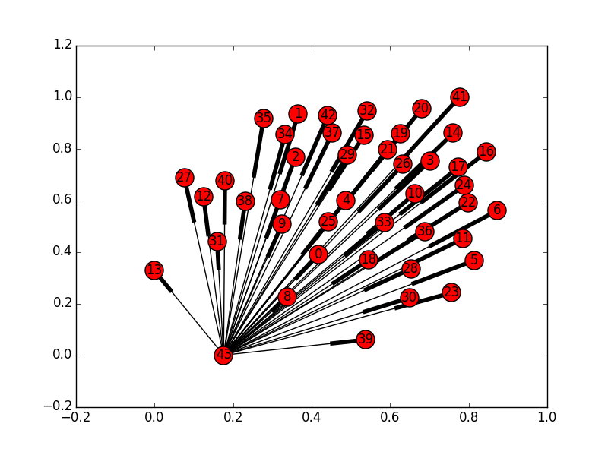
Graph Analysis(agree>10k)
Strongly Connected Components
- links number: 231416
- components nodes distribution:
[1853, 1, 1, 1, 1, 1, 1, 1, 1, …, 1]
- the first component:
- average shortest path length 2.11
- diameter 5
- radius 2
A really interesting distribution, like
islands surrounding the continent.

Slide 18
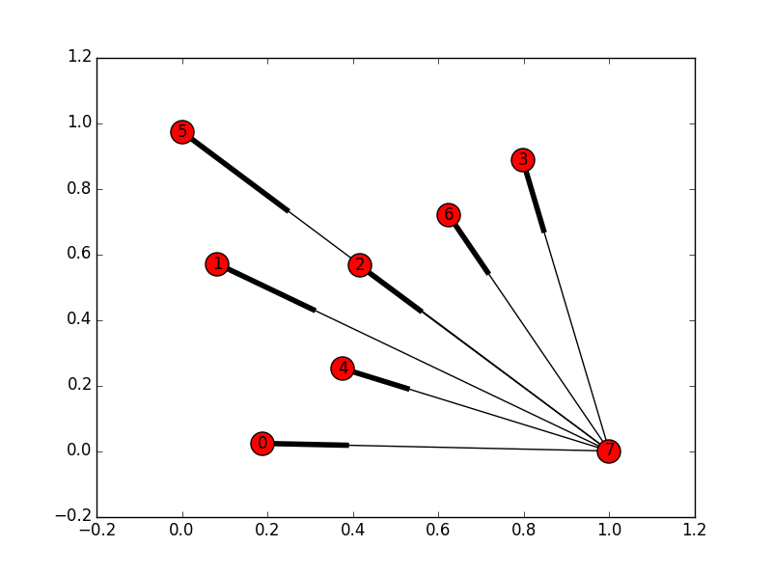


Graph Analysis(agree>50k)
Strongly Connected Components
- links number: 27324
- components nodes distribution:
[368, 1, 1, 1, 1, 1, 1, 1]
- the first component:
- average shortest path length 1.85
- diameter 4
- radius 2
Less ASPL and Diameter.

Slide 19
Graph Analysis(agree>10k)
Following and Topic
Dominant set(every user in the set follows at least one user in the group, 220 in 1896)
We count topics of questions answered by users from the set
Top 20:
调查类问题 3792, 生活 3096, 历史 1713, 恋爱 1464, 心理学 1432
电影 1419, 人际交往 1404, 社会 1332, 互联网 1214, 情感 1197 政治 1028, 两性关系 994, 教育 897, 中国 823, 人生 815 游戏 805, 文学 772, 知乎 772, 法律 750, 音乐 738
爱情 699, 文化 659,创业 628, 大学 621, 程序员 619 心理 617, 你如何评价 X 609, 女性 604, 编程 585, X 是种怎样的体验 582
Notes:
调查类问题 3792 生活 3096 历史 1713 恋爱 1464 心理学 1432 电影 1419 人际交往 1404 社会 1332 互联网 1214 情感 1197 政治 1028 两性关系 994 教育 897 中国 823 人生 815 游戏 805 文学 772 知乎 772 法律 750 音乐 738 爱情 699 文化 659 创业 628 大学 621 程序员 619 心理 617 你如何评价 X 609 女性 604 编程 585 X 是种怎样的体验 582 生活经历 568 恋爱心理 522 健康 521 学习 515 摄影 494 苹果公司 (Apple Inc.) 466 小说 460 生物学 460 阅读 455 医学 454 手机 452 计算机 451 婚姻 445 设计 444 健身 438 美食 435 物理学 431 NBA 427 军事 425 经济 425 职场 417 工作 414 篮球 405 科技 404 恋人相处 388 职业规划 386 生活常识 380 冷知识 377 日本 375 足球 362 美国 361 大学生 357 异性交往 353 哲学 350 汽车 348 宗教 344 iPhone 342 运动 341 Android 337 金融 332 个人情感咨询 332 台湾 332 影视评论 326 经济学 324 旅游 323 建筑 319 科学 316 女朋友 314 生活方式 312 投资 311 女生 309 脑洞 308 股票 307 社会学 305 男性 304 个人咨询 301 中国历史 295 佛教 286 英语 279 写作 279 儿童教育 276 产品经理 276 体育 275 市场营销 275 道德 275 旅行 270 知乎社区 269 数学 266 感情 265 战争 262

Slide 20
Graph Analysis(agree>50k)
Following and Topic
Dominant set(45 in 375), count topics of questions answered by users from the set
Top 20:
生活 1435, 调查类问题 1365, 政治 1285, 历史 1204, 电影 1084
健康 996, 社会 984, 医学 941, 恋爱 717, 中国 695
两性关系 688, 英语 678, 人际交往 640, 心理学 634, 互联网 595
法律 587, 微软（Microsoft） 555, 美国 552, 健身 538, 编程 511
Notes:
生活 1435
调查类问题 1365
政治 1285
历史 1204
电影 1084
健康 996
社会 984
医学 941
恋爱 717
中国 695
两性关系 688
英语 678
人际交往 640
心理学 634
互联网 595
法律 587
微软（Microsoft） 555
美国 552
健身 538
编程 511
经济 499
情感 494
计算机 489
翻译 473
音乐 472
程序员 469
Microsoft Windows 425
文化 403
腰椎间盘突出 402
游戏 393
英语翻译 378
文学 369
教育 361
女性 359
你如何评价 X 345
英语学习 342
知乎 330
手机 327
爱情 321
人生 316
国际政治 304
Android 303
音乐剧 298
性生活 295
X 是种怎样的体验 294
颈椎病 273
运动 273
旅游 268
心理 267
骨科 266
编程语言 265
科技 260
影视评论 249
金融 248
上海 247
笔记本电脑 243
科学 235
军事 235
学习 234
恋爱心理 234
日本 231
字体 230
生活经历 228
大学 227
经济学 225
苹果公司 (Apple Inc.) 221
电视剧 220
戏剧 207
生物学 206
阅读 200
艺术 199
女生 198
社会学 197
设计 196
民主 193
新闻 192
Windows 8 192
软件 192
恋人相处 191
道德 191
医生 188
物理学 188
男性 187
战争 187
运动损伤 187
操作系统 185
异性交往 184
数学 183
电影推荐 180
化学 178
魔兽世界 178
购机咨询 177
Windows Phone 175
话剧 175
生活常识 173
NBA 172
旅行 169
睡眠 168
国家 167
大学生 167

Slide 21
Summary
We have covered most of work we plan in the proposal, including: data crawling, basic statistics and graph analysis of both following relationship and topic related patterns of Zhihu.
There remains loads of interesting issues of such as:
analysis of the whole Zhihu data (may need months to crawl)
following-topic network analysis
topic extraction from the corpus of answers
…
We wish we could dig deeper in the future.

Slide 22

Q / A

